Slide 1
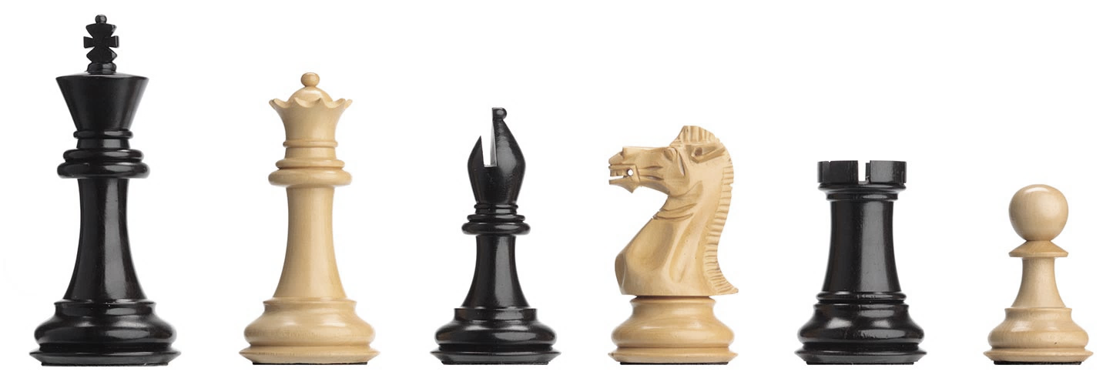
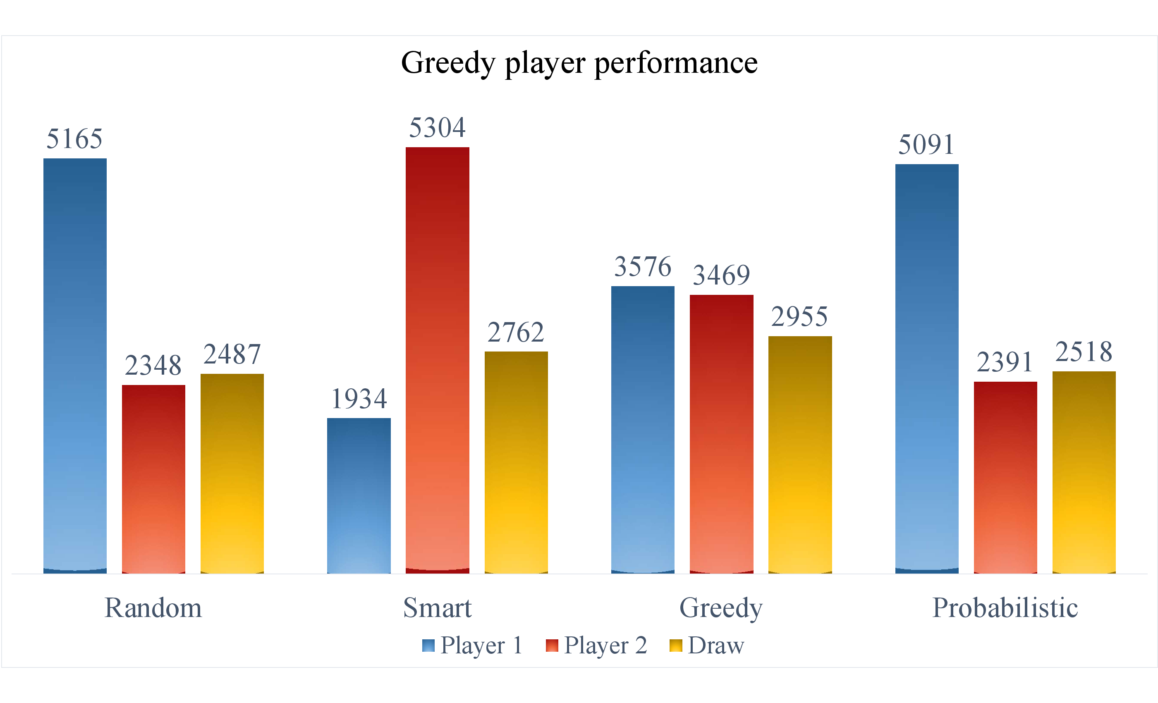
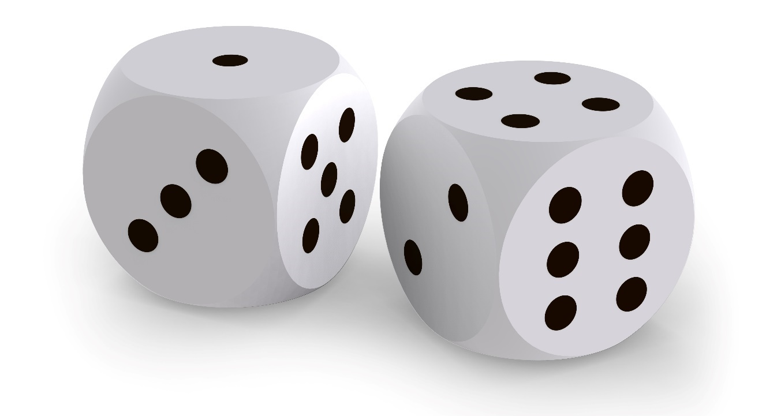
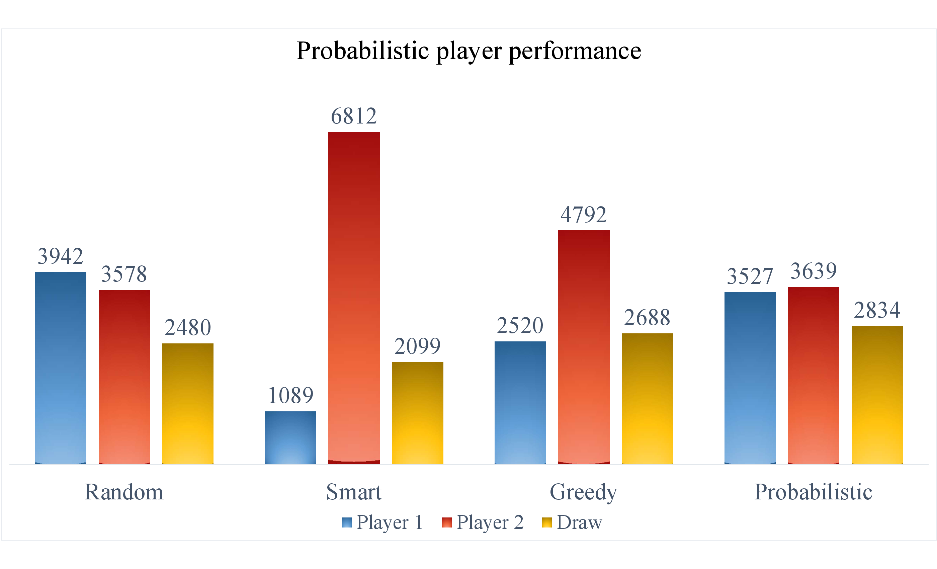
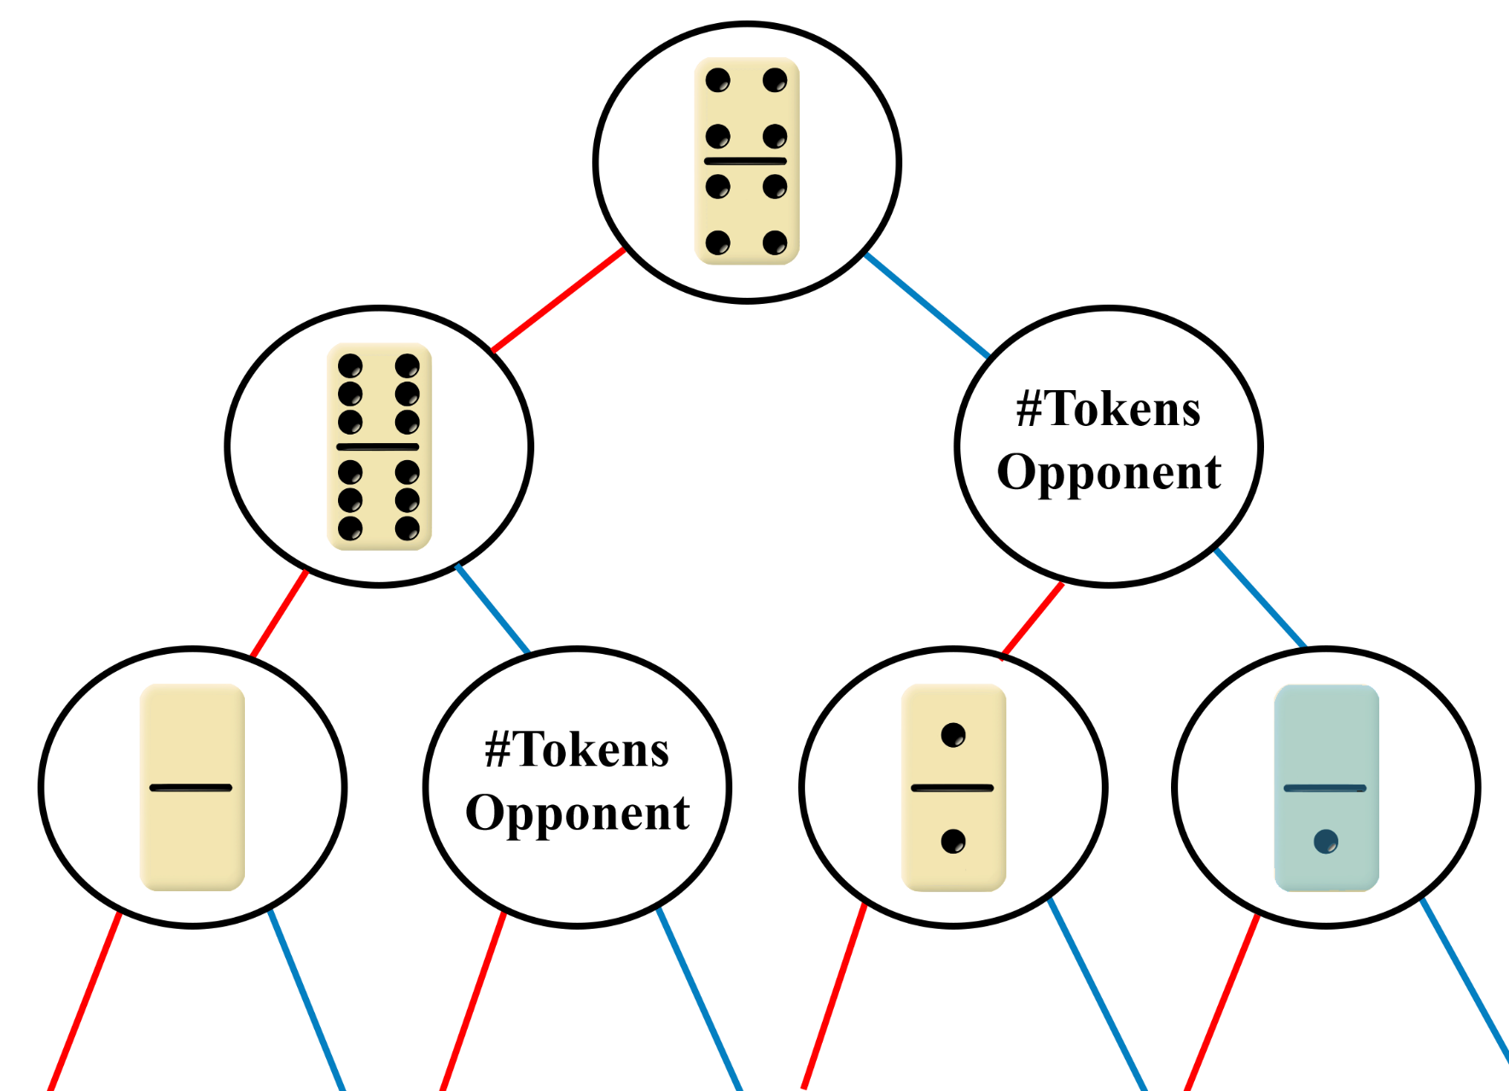

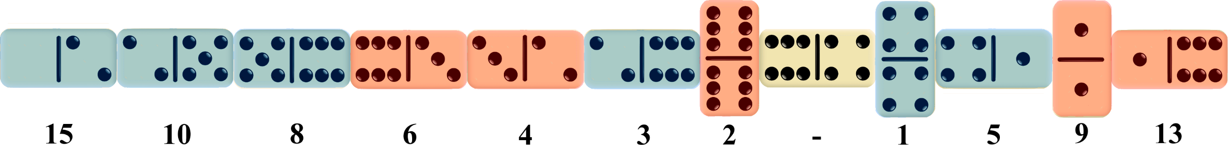
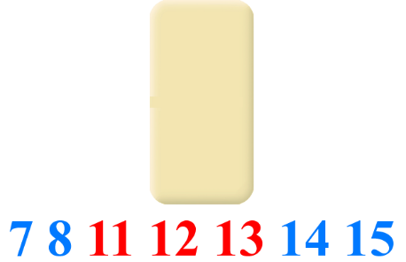
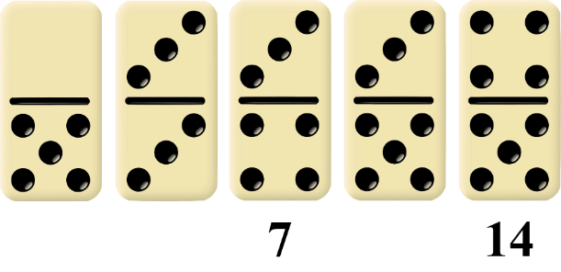
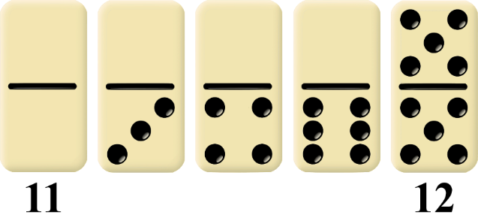
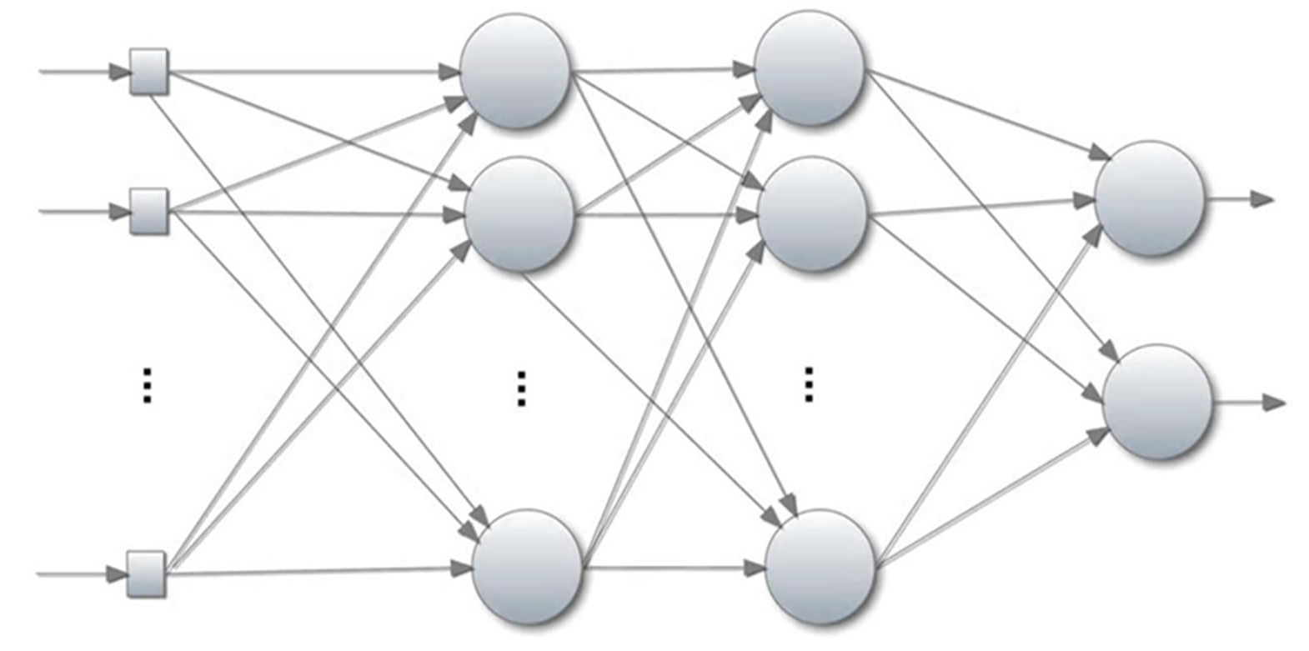


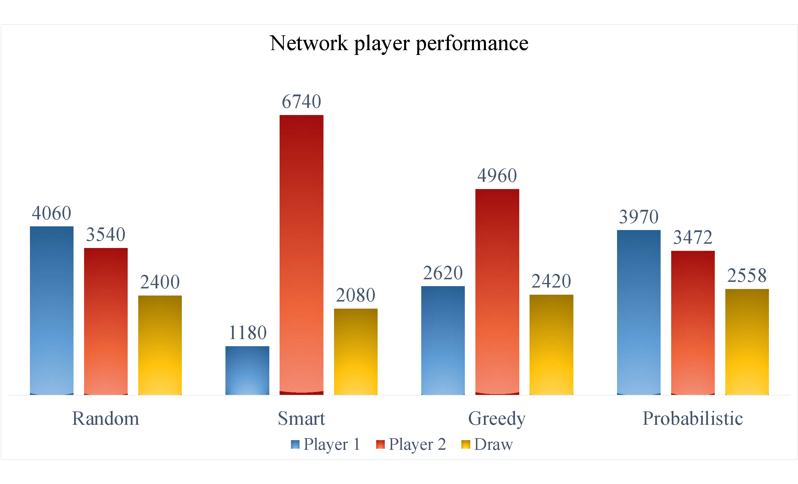
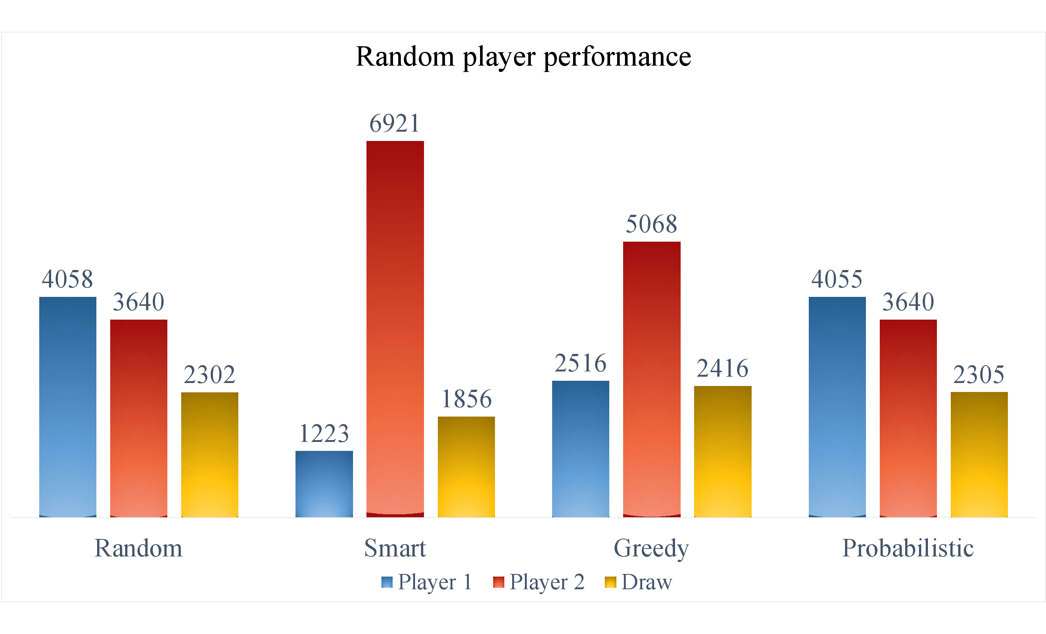
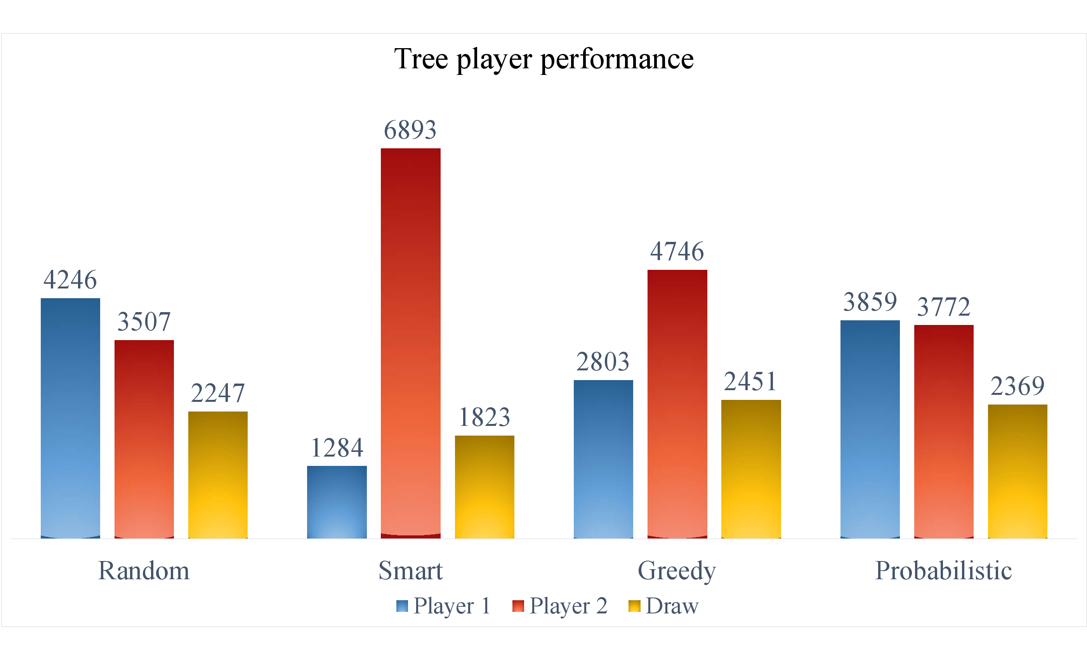
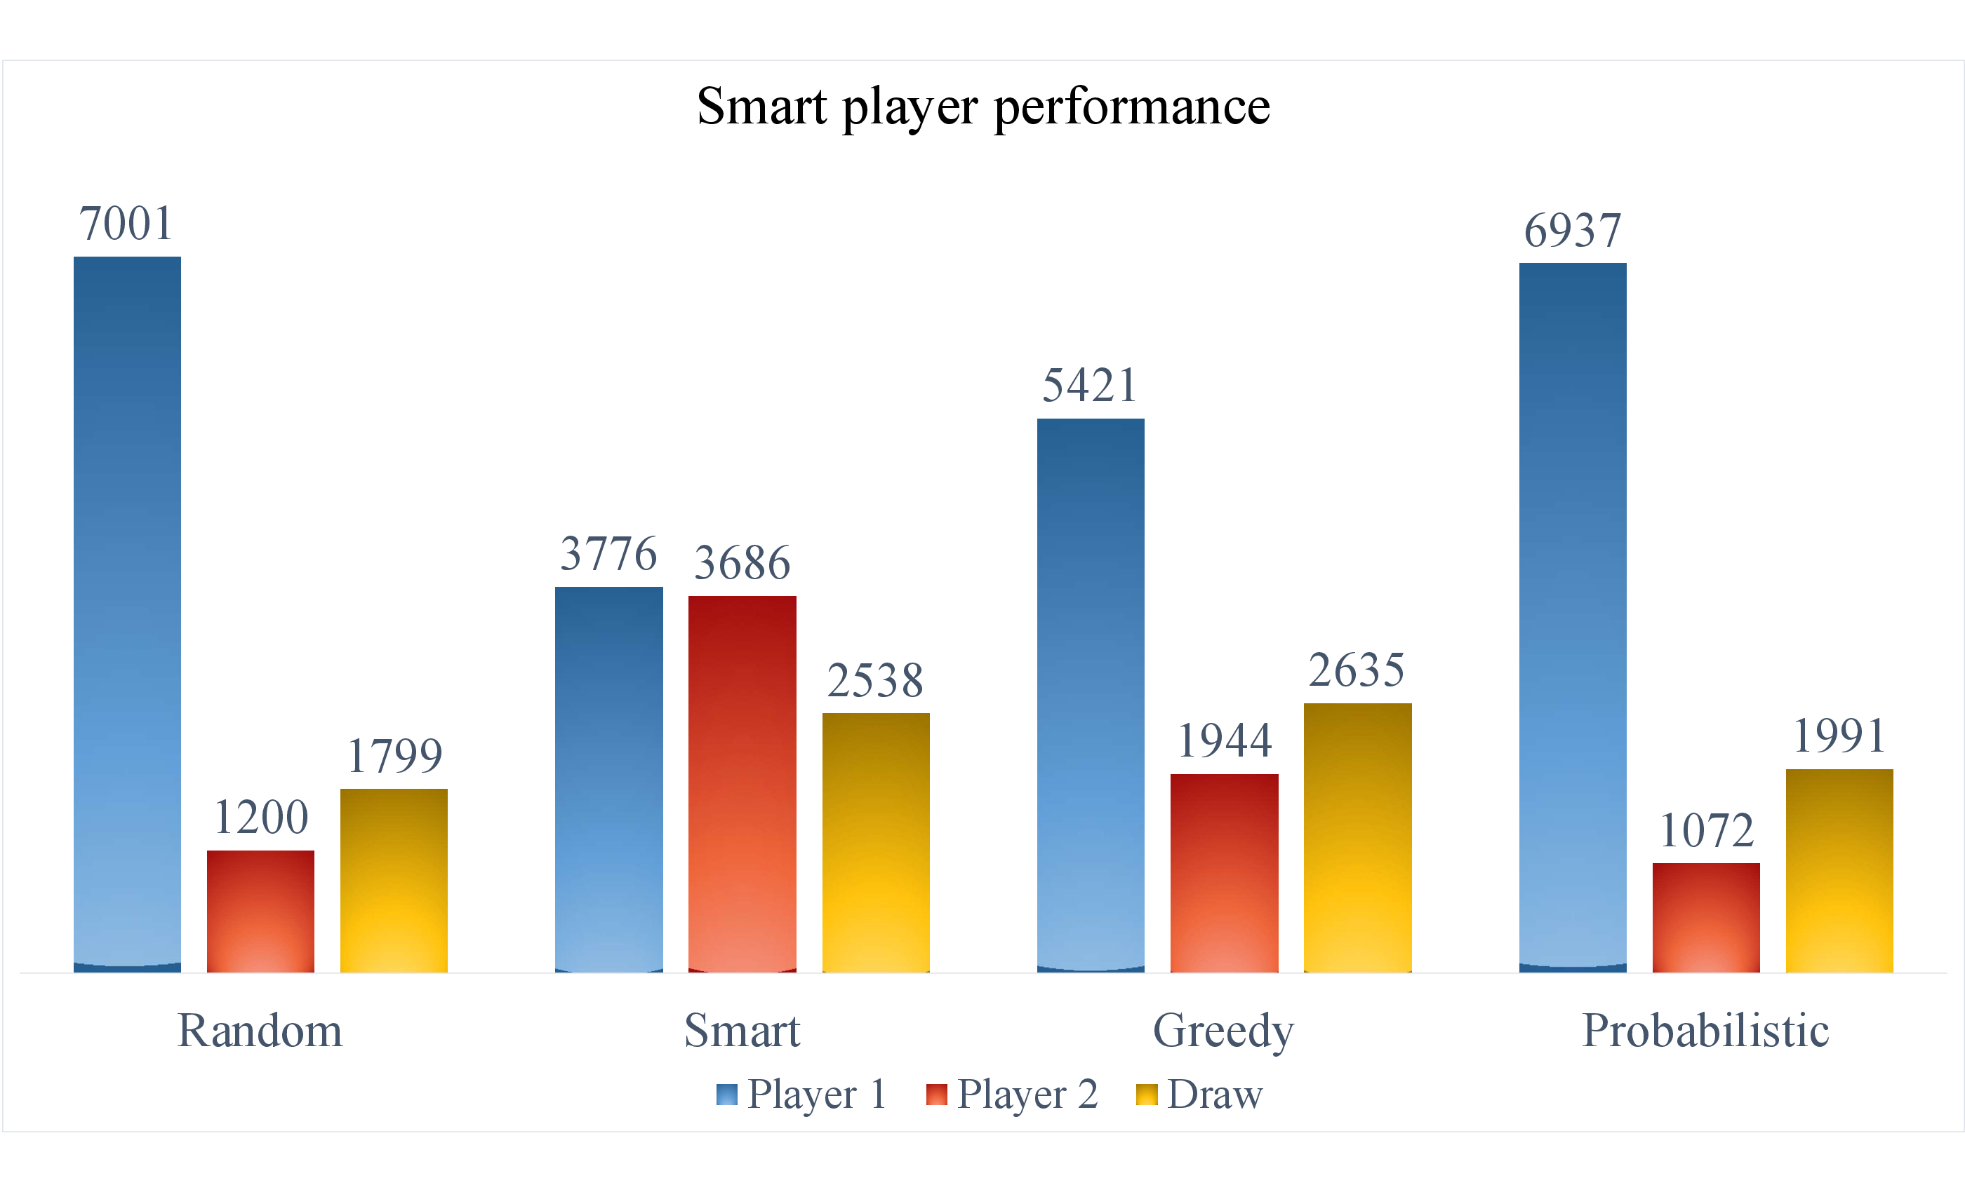
Analysis of the dominoes game: designing the best player
Ivan Yesid Castellanos, Jaime Andres Silva
Intelligent Systems, 2017 – I, Universidad Nacional de Colombia
INTRODUCTION
Games have historically been a popular benchmark for machines intelligence
The greedy player is also a cheater player, but it only evaluate a simple heuristic function for the state of the game after each possible move
Many different games have a probabilistic component and it is a challenge to get a smart player which could maximize the expected probability of the utilities
The probabilistic player is a “smart” player which looks for all the possible moves with the information a fair player have and uses an estimation of probability
OBJECTIVES
The main objective of the project is to use intelligent systems approaches to implement an smart player for the dominoes game.
Some intermediate objectives are the following:
Implement an environment for the dominoes game
Implement different initial players to see the behavior of the game
Collect automatically relevant data from the players
Train a model with the data to get an smart player
Compare with another models and players
MODELS
GAME
Decision Tree model, we build a classification decision tree based on the samples which decides if an action in a state is good, neutral or bad
Table
Stack
Turns
Second Player
It’s Second
Player Turn
9 Left
First Player
Neural Network model, we build a multi-perceptron to get an heuristic function Q which decides the expected utility of an action in a determined state
PLAYERS
Played Tokens
My Tokens
RESULTS
Number of Tokens
Opponent: 5
Left
Right
I’m the player 2
The random player is a legal player whom strategy is just to choose randomly one of the possible moves it can make in a turn
The trained players were tested against the other 4 players developed, in general the results are disappointing, none of the trained players got a really higher performance than the random one,
The smart player is a cheater player who can see the complete state of a game and uses an alpha-beta search to decide which action take in each turn
CONCLUSIONS
The basic dominoes game is too probabilistic to get strategies just from the information we have, the initial configuration of the game is a strong characteristic to have a winner.

